Slide 1
18ECO107T-Fiber Optics and Optoelectronics
L T P C:3 0 0 3
Prepared by ,
Dr.Christeena Joseph

Slide 2
Course Learning Rationale (CLR):
The purpose of learning this course is to:
Analyze the basic laws and theorems of light associated with the optical fiber communication and the classification of optical fibers.
Address concepts related to transmission characteristics such as attenuation and dispersion.
Explore the fundamentals of optoelectronics display devices, Sources and Detectors.
Gain to information on Optical modulators and amplifiers
Illustrate the integration methods available for optoelectronic circuits and devices
Utilize the basic optical concepts applied in various engineering problems and identify appropriate solutions

Slide 3
Course Learning Outcomes (CLO):
Review the basic theorems related to fiber optic communication, and attain knowledge of types of optical fibers.
Understand the optical signal distortion factors in optical fiber communication.
Familiarize the principle and operation of various display devices, light sources and detectors.
Acquire knowledge of various optoelectronic modulators and amplifiers.
Understand the various optoelectronic integrated circuits.
Acquire fundamental concepts related to optical communication and optoelectronic devices

Slide 4
UNIT I-Introduction to Optical Fibers
Evolution of fiber optic system-Elements of an optical fiber transmission link-Advantages of fiber optic system-Characteristics and behavior of light-Total internal reflection-Acceptance angle-Numerical aperture, Critical angle-Solving Problems-Ray optics-Types of rays-Optical fiber modes-Optical fiber configurations-Single mode fibers-Multimode Fibers-Step Index Fibers-Graded Index Fibers

Slide 5
Learning Resources
1. Gerd Keiser, “Optical Fiber Communications”, 5th Edition, McGraw Hill Education (India), 2015.
2. Khare R P, “Fiber Optics and Optoelectronics”, Oxford University Press, 2014.
3.J. Wilson and J. Hawkes, “Optoelectronics – An Introduction”, Prentice Hall, 1995.
4. Pallab Bhattacharya, “Semiconductor Optoelectronic Devices”, Prentice Hall of India Pvt. Ltd, 2006.

Slide 6

Evolution of communication system
Principle interests of human beings has been to devise communication systems for sending messages from one distant place to another.The fundamental elements of any such communication system is shown Fig 1-1
Information source-inputs message to transmitter
Transmitter –couples message to transmission channel
Channel- medium bridging distance between transmitter and receiver. Types: 1)guided: wire/waveguide
2) Unguided: atmospheric/space channel.
Signal while traversing through channel, it may be attenuated and distorted with distance
Receiver- Extract weakened and distorted signal from channel, amplify it and restore to original form

Slide 7
FORMS OF COMMUNICATION SYSTEM
Motive:
to improve fidelity,
increase data rate so more information could be send
Increase transmission distance between relay stations.
Evolution:
Before 19th century-use of fire signal by greeks in 8th century B.C for sending alarms, calls for help or announcements of certains events.
150B.c.-optical signals were encoded relation to alphabet ,so any message could be sent
Limitations: eye used as receiver, LOS transmission paths required.
Telegraph _Samuel.F.B.Morse in 1838 (1844-commercial telegraph implemented)
Used wire cables for information transmission-High frequency carriers used –bandwidth increased so as information capacity.
Applications:Televeision,Radar,Microwavelink
Transmission media used :millimeter and microwave waveguide,metallic wires
Another part of EM spectrum is optical range 50nm(ultraviolet)to about 100Micrometer(far infrared),visible spectrum (400nm to 700nm)band.

Slide 8
Evolution of Fiber optic system
Advent of laser (coherent source)in 1960 paved way for this system.
Optical frequency is 5x10^14Hz, information capacity is 10^5 times greater than microwave system(~10 million TV channels)
Unguided limitations: atmospheric channel by rain,fog,snow and dust make high-speed carrier system economically unattractive in view of present demand of channel capaciy.
It covers only short-distance(up to 1 km)
Optical fiber-more reliable and versatile optical channel than atmosphere, but extremely large loss(more than 1000dB/km) made them impractical
Losses due to impurities in fiber material. In 1970, silica fiber having 20dB/km attenuation was fabricated. Later attenuation reduced to 0.16dB/km at 1550-num
Development of optical fiber system grew from combination of semiconductor technology(gives light sources and photo detectors and optical waveguide technology)

Slide 9
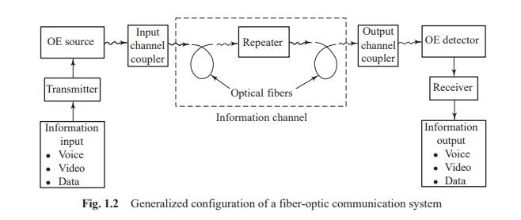
Elements of an optical fiber transmission link

Slide 10
Elements of an optical fiber transmission link
Information Input:
The information input may be in any of the several physical forms, e.g., voice, video, or data.
Therefore an input transducer is required for converting the non-electrical input into an electrical input.
For example, a microphone converts a sound signal into an electrical current, a video camera converts an image into an electric current or voltage, and so on.
In situations where the fiber-optic link forms a part of a larger system, the information input is normally in electrical form.

Slide 11
Transmitter:
The transmitter (or the modulator, as it is often called) comprises an electronic stage which (i) converts the electric signal into the proper form and (ii) impresses this signal onto the electromagnetic wave (carrier) generated by the optoelectronic source.
The modulation of an optical carrier may be achieved by employing either an analog or a digital signal.
An analog signal varies continuously and reproduces the form of the original information input, whereas digital modulation involves obtaining information in the discrete form.
In the latter, the signal is either on or off, with the on state representing a digital 1 and the off state representing a digital 0.

Slide 12
The number of bits per second (bps) transmitted is called the data rate.
If the information input is in the analog form, it may be obtained in the digital form by employing an analog-to-digital converter.
Analog modulation is much simpler to implement but requires higher signal-to noise ratio at the receiver end as compared to digital modulation.
Further, the linearity needed for analog modulation is not always provided by the optical source, particularly at high modulation frequencies.
Therefore, analog fiber-optic systems are limited to shorter distances and lower bandwidths

Slide 13
Optoelectronic Source
An optoelectronic (OE) source generates an electromagnetic wave in the optical range (particularly the near-infrared part of the spectrum), which serves as an information carrier.
Common sources for fiber-optic communication are the light-emitting diode (LED) and the injection laser diode (ILD).
Ideally, an optoelectronic source should generate a stable single-frequency electromagnetic wave with enough power for long haul transmission.
However, in practice, LEDs and even laser diodes emit a range of frequencies and limited power.
The favorable properties of these sources are that they are compact, lightweight, consume moderate amounts of power, and are relatively easy to modulate.
Furthermore, LEDs and laser diodes which emit frequencies that are less attenuated while propagating through optical fibers are available.

Slide 14
Channel Couplers:
In fiber-optic systems, the function of a coupler is to collect the light signal from the optoelectronic source and send it efficiently to the optical fiber cable.
However, the coupling losses are large owing to Fresnel reflection and limited light-gathering capacity of such couplers.
At the end of the link again a coupler is required to collect the signal and direct it onto the photodetector.

Slide 15
Fiber-optic Information Channel
In communication systems, the term ‘information channel’ refers to the path between the transmitter and the receiver.
In fiber-optic systems, the optical signal traverses along the cable consisting of a single fiber or a bundle of optical fibers.
An optical fiber is an extremely thin strand of ultra-pure glass designed to transmit optical signals from the optoelectronic source to the optoelectronic detector.
In its simplest form, it consists of two main regions: (i) a solid cylindrical region of diameter 8–100 mm called the core and (ii) a coaxial cylindrical region of diameter normally 125 mm called the cladding.

Slide 16
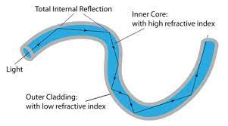

Slide 17
The refractive index of the core is kept greater than that of the cladding. This feature makes light travel through this structure by the phenomenon of total internal reflection.
In order to give strength to the optical fiber, it is given a primary or buffer coating of plastic, and then a cable is made of several such fibers.
This optical fiber cable serves as an information channel.
For clarity of the transmitted information, it is required that the information channel should have low attenuation for the frequencies being transmitted through it and a large light-gathering capacity.

Slide 18
Repeater
As the optical signals propagate along the length of the fiber, they get attenuated due to absorption, scattering, etc., and broadened due to dispersion.
After a certain length, the cumulative effect of attenuation and dispersion causes the signals to become weak and indistinguishable.
Therefore, before this happens, the strength and shape of the signal must be restored.
This can be done by using either a regenerator or an optical amplifier, e.g., an erbium-doped fiber amplifier (EDFA), at an appropriate point along the length of the fiber

Slide 19
Optoelectronic Detector
The reconversion of an optical signal into an electrical signal takes place at the OE detector.
Semiconductor p-i-n or avalanche photodiodes are employed for this purpose.
The photocurrent developed by these detectors is normally proportional to the incident optical power and hence to the information input.
The desirable characteristics of a detector include small size, low power consumption, linearity, flat spectral response, fast response to optical signals, and long operating life

Slide 20
Receiver
For analog transmission, the output photocurrent of the detector is filtered to remove the dc bias that is normally applied to the signal in the modulator module, and also to block any other undesired frequencies accompanying the signal.
After filtering, the photocurrent is amplified if needed.
These two functions are performed by the receiver module.
For digital transmission, in addition to the filter and amplifier, the receiver may include decision circuits.
If the original information is in analog form, a digital-to analog converter may also be required.
The design of the receiver is aimed at achieving high sensitivity and low distortion.
The signal-to-noise ratio (SNR) and bit-error rate (BER) for digital transmission are important factors for quality communication.

Slide 21
Information Output
Finally, the information must be presented in a form that can be interpreted by a human observer.
For example, it may be required to transform the electrical output into a sound wave or a visual image. Suitable output transducers are required for achieving this transformation.
In some cases, the electrical output of the receiver is directly usable.
This situation arises when a fiber-optic system forms the link between different computers or other machines.

Slide 22
ADVANTAGES OF FIBER-OPTIC SYSTEMS
Long Distance Transmission
Optical fibers have lower transmission losses compared to copper wires. Consequently data can be sent over longer distances, thereby reducing the number of intermediate repeaters needed to boost and restore signals in long spans.
This reduction in equipment and components decreases system cost and complexity.
Large Information Capacity
Optical fibers have wider bandwidths than copper wires, so that more information can be sent over a single physical line.
This property decreases the number of physical lines needed for sending a given amount of information.
Small Size and Low Weight
The low weight and the small dimensions of fibers offer a distinct advantage over heavy, bulky wire cables in crowded underground city ducts or in ceiling-mounted cable trays.
This feature also is of importance in aircraft, satellites, and ships where small, low weight cables are advantageous, and in tactical military applications where large amounts of cable must be unreeled and retrieved rapidly

Slide 23
Immunity to Electrical Interference
An especially important feature of an optical fiber relates to the fact that it is a dielectric material, which means it does not conduct electricity.
This makes optical fibers immune to the electromagnetic interference effects seen in copper wires, such as inductive pickup from other adjacent signal-carrying wires or coupling of electrical noise into the line from any type of nearby equipment.
Enhanced Safety
Optical fibers offer a high degree of operational safety because they do not have the problems of ground loops, sparks, and potentially high voltages inherent in copper lines.
However, precautions with respect to laser light emissions need to be observed to prevent possible eye damage.
Increased Signal Security
An optical fiber offers a high degree of data security because the optical signal is well-confined within the fiber and an opaque coating around the fiber absorbs any signal emissions.
This feature is in contrast to copper wires where electrical signals potentially could be tapped off easily. Thus optical fibers are attractive in applications where information security is important, such as financial, legal, government, and military systems

Slide 24
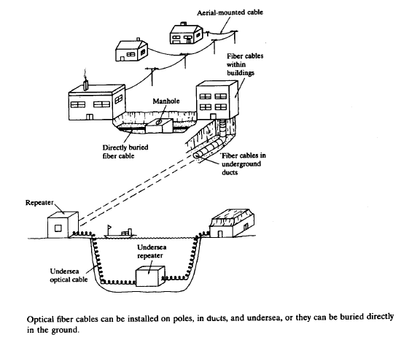

Slide 25
A variety of fiber types with different performance characteristics exist for a wide range of applications.
To protect the glass fibers during installation and service, there are many different cable configurations depending on whether the cable is to be installed inside a building, underground in ducts or through direct-burial methods, outside on poles, or under water.
Very low-loss optical connectors and splices are needed in all categories of optical fiber networks for joining cables and for attaching one fiber to another

Slide 26
The installation of optical fiber cables can be either aerial, in ducts, undersea, or buried directly in the ground.
The cable structure will vary greatly depending on the specific application and the environment in which it will be installed.
Owing to installation and/or manufacturing limitations, individual cable lengths for inbuilding or terrestrial applications will range from several hundred meters to several kilometers.
Practical considerations such as reel size and cable weight determine the actual length of a single cable section.
The shorter segments tend to be used when the cables are pulled through ducts.
Longer lengths are used in aerial, direct-burial, or underwater applications

Slide 27
Workers can install optical fiber cables by pulling or blowing them through ducts (both indoor and outdoor) or other spaces, laying them in a trench outside, plowing them directly into the ground, suspending them on poles, or laying or plowing them underwater.
Although each method has its own special handling procedures, they all need to adhere to a common set of precautions.
These include avoiding sharp bends of the cable, minimizing stresses on the installed cable, periodically allowing extra cable slack along the cable route for unexpected repairs, and avoiding excessive pulling or hard yanks on the cable.
For direct-burial installations a fiber optic cable can be plowed directly underground or placed in a trench that is filled in later.
Figure illustrates a plowing operation that may be carried out in nonurban areas.
The cables are mounted on large reels on the plowing vehicle and are fed directly into the ground by means of the plow mechanism

Slide 28


Slide 29
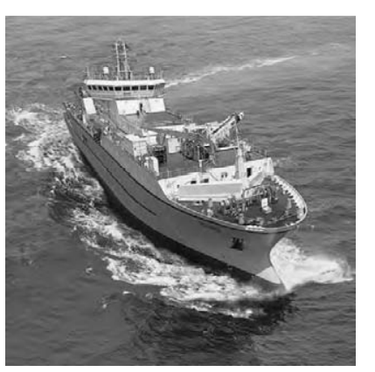
Transoceanic cable lengths can be many thousands of kilometers long and include periodically spaced (on the order of 80–120 km) optical repeaters to boost the signal level.
The cables are assembled in onshore factories and then are loaded into special cable-laying ships, as illustrated in Figure

Slide 31
optical fiber
An optical fiber (or fibre) is a flexible, transparent fiber made by drawing glass (silica) or plastic to a diameter slightly thicker than that of a human hair.
Optical fibers are used most often as a means to transmit light between the two ends of the fiber and find wide usage in fiber-optic communications, where they permit transmission over longer distances and at higher bandwidths (data transfer rates) than electrical cables.
Fibers are used instead of metal wires because signals travel along them with less loss; in addition, fibers are immune to electromagnetic interference, a problem from which metal wires suffer.
Fibers are also used for illumination and imaging, and are often wrapped in bundles so they may be used to carry light into, or images out of confined spaces, as in the case of a fiberscope.
Specially designed fibers are also used for a variety of other applications, some of them being fiber optic sensors and fiber lasers.

Slide 32
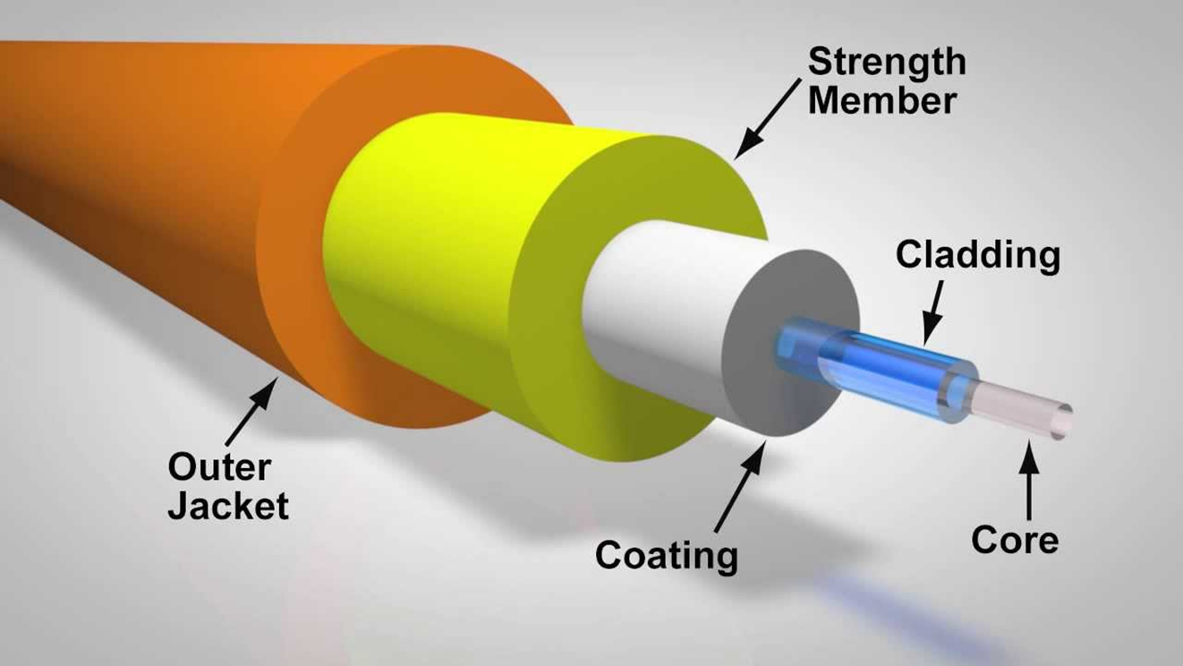

Slide 33
Optical fiber structure
Optical fibers typically include a core surrounded by a transparent cladding material with a lower index of refraction.
Light is kept in the core by the phenomenon of total internal reflection which causes the fiber to act as a waveguide.
Fibers that support many propagation paths or transverse modes are called multi-mode fibers, while those that support a single mode are called single-mode fibers (SMF).
Multi-mode fibers generally have a wider core diameter and are used for short-distance communication links and for applications where high power must be transmitted.

Slide 34
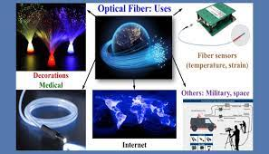
Optical fiber –various applications

Slide 35
Characterisitcs and Behaviour of light
Fiber optics technology involves the emission, transmission, and detection of light let us discuss the nature of light.
Two methods usually used to describe how optical fiber guides light.
Geometrical or ray optics concepts of light: reflection and refraction to provide a picture of the propagation mechanisms.
Electromagnetic wave approach: where light is treated as an EM wave which propagates along the optical fiber waveguide.(This involves maxwell’s equation subject to cylindrical boundary conditions of fiber.)

Slide 36
The nature of light
Until 17th century, it is believed that light consists of a stream of minute particles that are emitted by luminous sources.
Particles travel in straight line , and assumed to penetrate transparent but reflected from opaque ones.
Described large-scale optical effects like reflection and refraction, but failed to explain interference and diffraction.
Diffraction explanation given by Fresnel in 1815 could be interpreted on assumption that light is a wave motion.
In 1864, Maxwell theorized that light waves must be electromagnetic in nature.
After observation of polarization effects indicated that light waves are transverse(that is, the wave motion is perpendicular to the direction in which the wave travels).
In wave or physical optical view point EM waves radiated by small optical source can be represented by train of spherical wave front(locus of all points in the wave train which have the same phase).
If wavelength of light is smaller than object(or opening ) which it encounters, the wavefront appears as straight lines to this object or opening. In this case, light wave can be represented as a plane wave, and its direction of travel can be indicated by light ray which is perpendicular to the phase front.

Slide 37
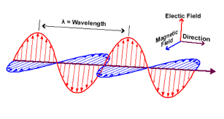

Slide 38
REVIEW OF FUNDAMENTAL LAWS OF OPTICS
In free space, light travels at a speed of c=3*10^8m/s.
Speed of light related to frequency v wavelength λ by c=v λ
The most important optical parameter of any transparent medium is its refractive index n.
It is defined as the ratio of the speed of light in vacuum (c) to the speed of light in the medium (v).
n=c/v
As v is always less than c, n is always greater than 1. Values of n are (1.00 for air, 1.33 for water, 1.50 for glass , and 2.42 for diamond)

Slide 39
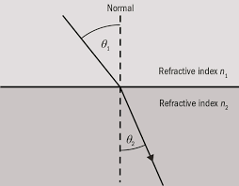

Slide 40
The concepts of reflection and refraction can be interpreted most easily by considering the behavior of light rays associated with plane waves traveling in a dielectric material.
When a light ray encounters a boundary separating two different media, part of the ray is reflected back into the first medium and the remainder is bent (or refracted) as it enters the second material.
The bending or refraction of the light ray at the interface is a result of the difference in the speed of light in two materials that have different refractive indices.
The relationship at the interface is known as Snell’s law

Slide 41

Snell’s law.
The phenomenon of refraction of light at the interface between two transparent media of uniform indices of refraction is governed by Snell’s law.
Consider a ray of light passing from a medium of refractive index n₁ into a medium of refractive index n₂ [Assume that n₁ > n₂ and that the angles of incidence and refraction with respect to the normal to the interface are, respectively, Φ₁ and Φ₂.Then, according to Snell’s law

Slide 42
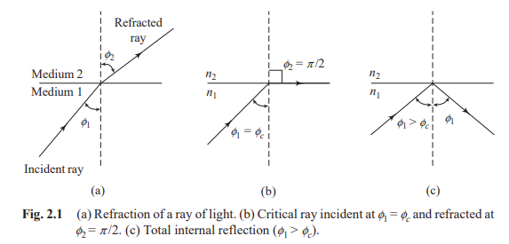

Slide 43
As n₁ > n₂, if we increase the angle of incidence Φ₁, the angle of refraction Φ₂ will go on increasing until a critical situation is reached, when for a certain value of Φ₁ = Φ_{c}, Φ₂ becomes π /2, and the refracted ray passes along the interface.
This angle Φ₁ = Φ_{c} is called the critical angle.
If we substitute the values of Φ₁ = Φ_{c} and Φ₂ = π /2 in Eq ,
we see that n₁sin Φ_{c} = n₂sin(π /2) = n₂
Thus sin Φ_{c} = n_{2/}n₁

Slide 44
If the angle of incidence Φ₁ is further increased beyond Φ_{c}, the ray is no longer refracted but is reflected back into the same medium. This is ideally expected.
This is called total internal reflection. It is this phenomenon that is responsible for the propagation of light through optical fibers.
In practice, however, there is always some tunnelling of optical energy through this interface. The wave carrying away this energy is called the evanescent wave.

Slide 45
According to law of reflection the angle at which incident ray strikes the interface is exactly equal to the angle the reflected ray makes with the same interface.
Incident ray, normal to the interface, reflected ray all lie in the same plane, which is perpendicular to the interface plane between two materials.
When light traveling in certain medium is reflected off an optically denser material (one with high refractive index), its called external reflection.
Conversely, reflection of light off of less optically dense material (such as light traveling in glass being reflected at a glass-to-air interface) is called internal reflection.

Slide 46
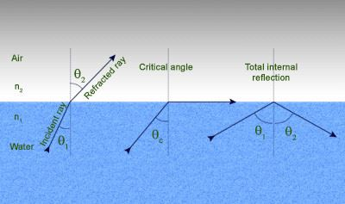
Condition required for total internal reflection can be determined by using snell’s law.

Slide 47

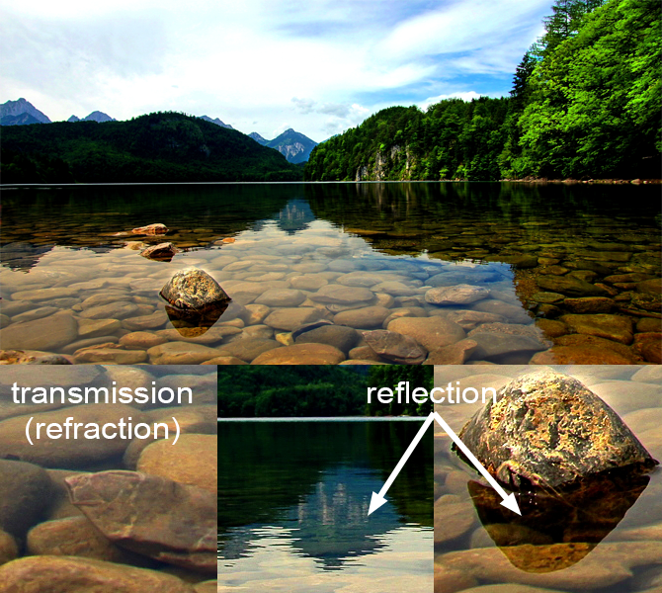
Total internal reflection examples

Slide 48
Problems
Problem 1
Consider the interface between a glass slab with n₁ = 1.48 and air for which n₂ = 1.00. What is the critical angle for light traveling in the glass?

Slide 49
Solution
sin Φ_{c} = n₂/n₁
Φ_{c}=sin⁻¹(n₂/n₁)
Φ_{c} =sin⁻¹(1/1.48)
Φ_{c} = sin⁻¹(0.678)
Φ_{c} = 42.5º
Thus any light ray traveling in the glass that is incident on the glass–air interface at a normal angle Φ₁ greater than 42.5° is totally reflected back into the glass.

Slide 50
Problem 2
A light ray traveling in air (n₁ = 1.00) is incident on a smooth, flat slab of crown glass, which has a refractive index n₂ = 1.52. If the incoming ray makes an angle of Φ₁ = 30.0° with respect to the normal, what is the angle of refraction Φ₂ in the glass?

Slide 51
Solution
From Snell’s law
n₁sin Φ₁ = n₂sin Φ₂
sin Φ₂₌ (n₁/n₂)sin Φ₁
sin Φ₂₌ (1/1.52)sin30º
sin Φ₂₌ 0.658x0.5=0.329
Φ₂ = sin⁻¹(0.329)=19.2º

Slide 52
To Practice….
An unknown glass has an index of refraction of n=1.5 . For a beam of light originated in the glass, at what angles the light 100% reflected back into the glass. (The index of refraction of air is n_{air}=1.00).

Slide 53
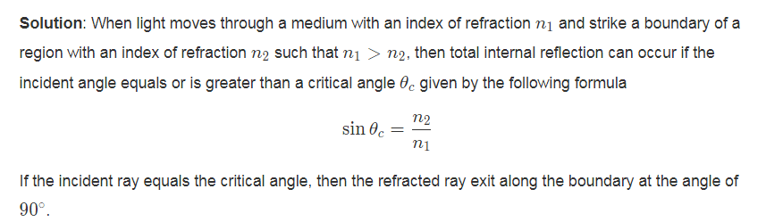
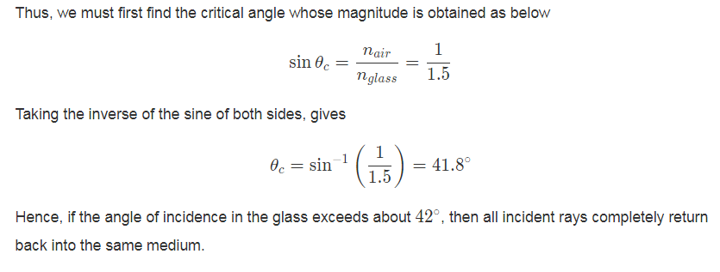
Total Internal Reflection Problems
Problem (1): An unknown glass has an index of refraction of n=1.5 . For a beam of light originated in the glass, at what angles the light 100% reflected back into the glass. (The index of refraction of air is n_{air}=1.00).

Slide 54
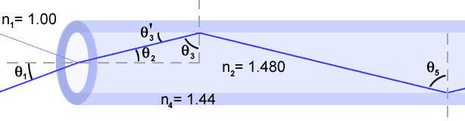
Total Internal Reflection Problems
Consider the optical fiber from Fig . The index of refraction of the inner core is 1.480 , and the index of refraction of the outer cladding is 1.44.
A. What is the critical angle for the core-cladding interface?
B. For what range of angles in the core at the entrance of the fiber (q₂) will the light be completely internally reflected at the core-cladding interface?
C. What range of incidence angles in air does this correspond to?
D. If light is totally internally reflected at the upper edge of the fiber, will it necessarily be totally internally reflected at the lower edge of the fiber (assuming edges are parallel)?

Slide 55
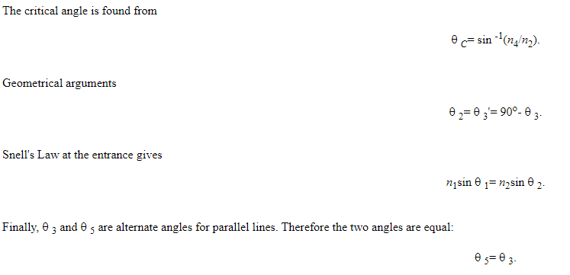

Slide 56
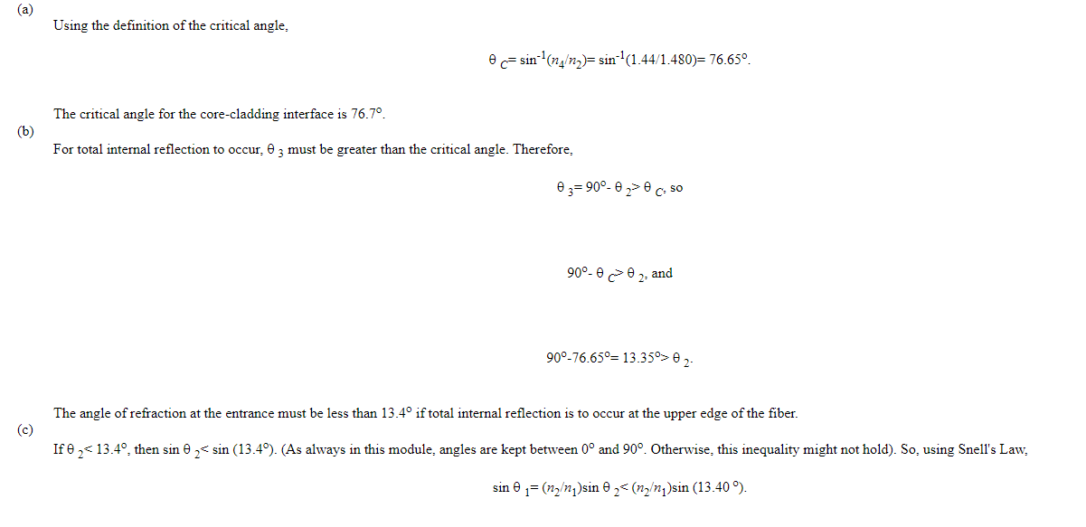

Slide 57
